Slide 1

Online Shoppers Intentions
ARAVINDHAN R

Slide 2

Problem Statement
This is the data of an online retailing company where they are trying to find which online shopper will generate revenue by his/her online shoppers’ activity on their site.

Slide 3
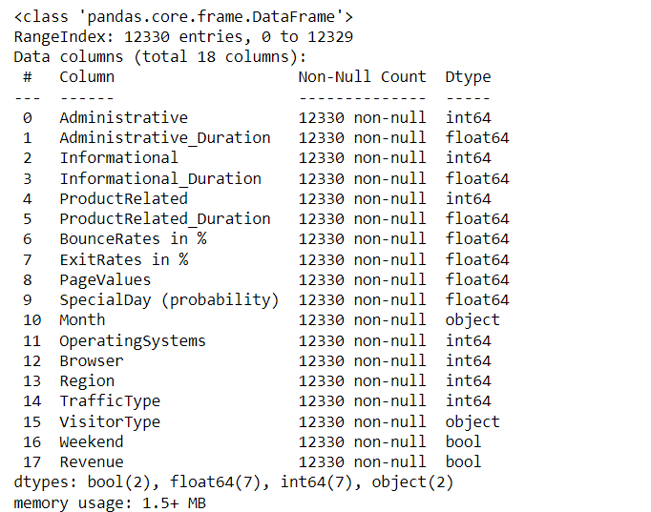
Structure of the Data
The data has 12330 rows and 18 columns.

Slide 4
DATA CLEANING

Slide 5
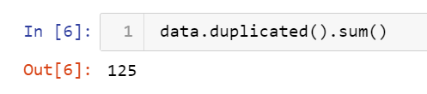
Finding duplicates in rows
There are around 125 duplicates in the datasets. Which has been removed

Slide 6
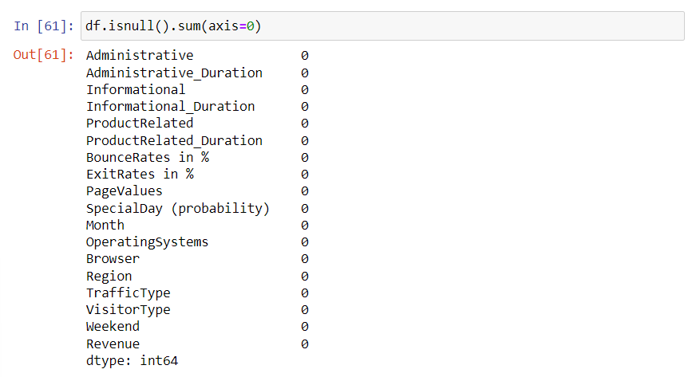
Null Values
There are no null values in the data that we are provided.
The columns OperatingSystems and Browser are irrelevant in this context and can be dropped out of the dataframe.

Slide 7
Label Encoding
The data type of VisitorType and Month is object. Since these columns contain qualitative data, they are needed to be encoded to quantitative data.
One hot label encoding technique is used for transforming VisitorType Column.
Month column is transformed to their corresponding month numbers using a custom function.
To avoid multicollinearity issues , VisitorType and Other columns are dropped from the dataframe.

Slide 8
Heatmap
Using heatmap trying to find the collinearity between columns.
Any possibilities to drop the columns if needed.

Slide 9
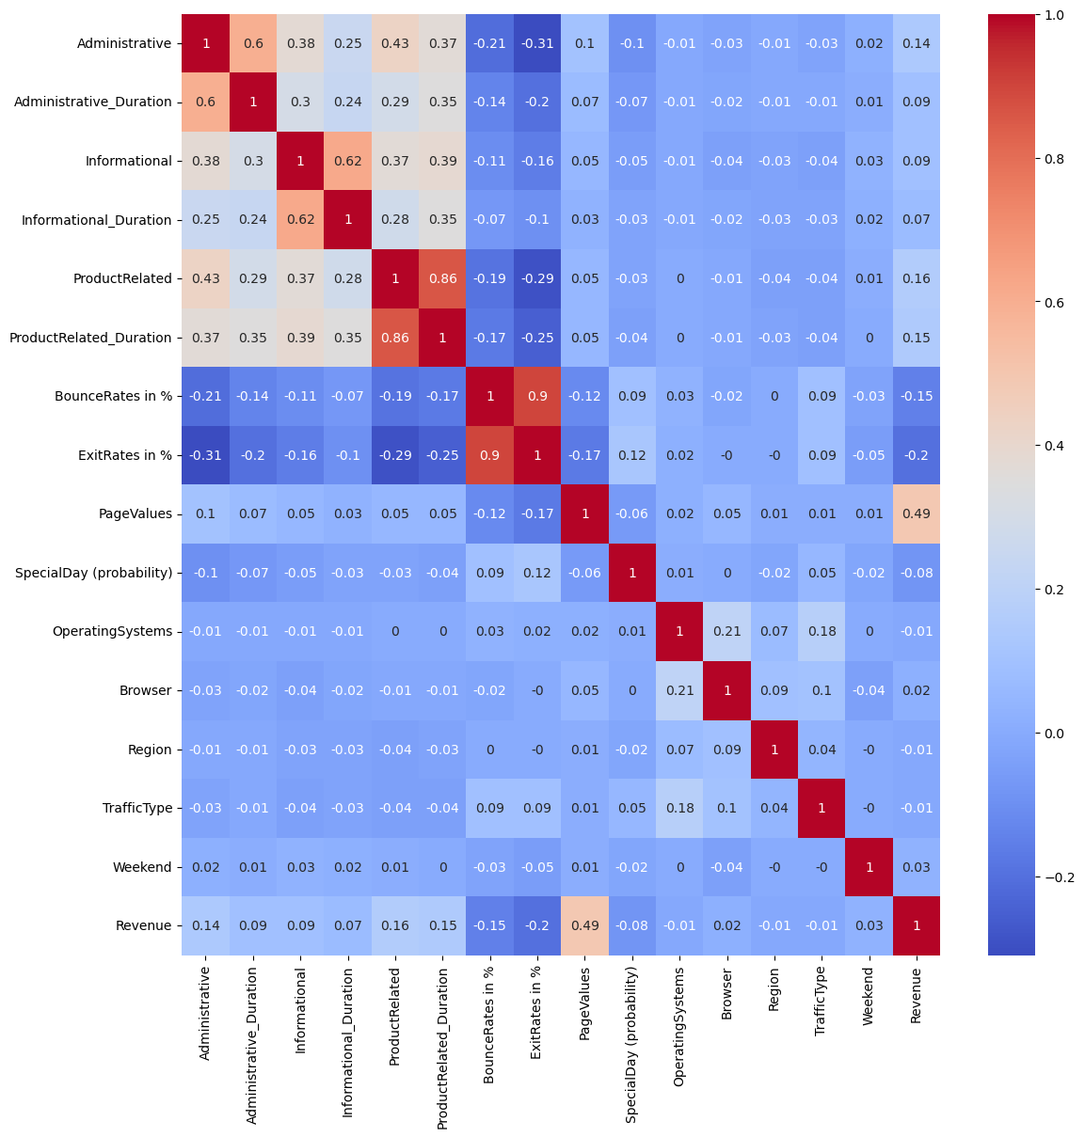

Slide 10

DATA VISULAIZATION

Slide 11

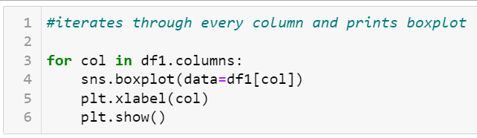
Outlier detection
Taking numerical values to found outliers.
Excluded remaining datatypes.
And Iterated through every column and used boxplot to plot.

Slide 12
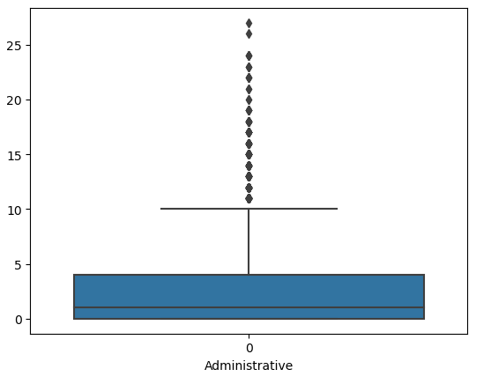
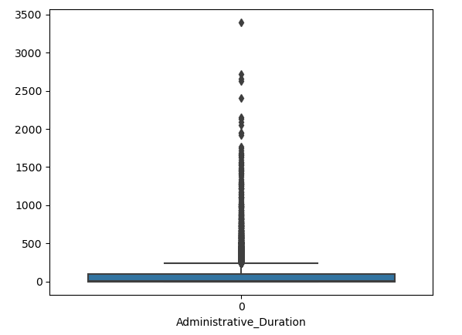
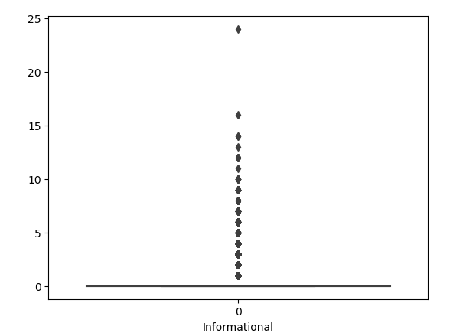
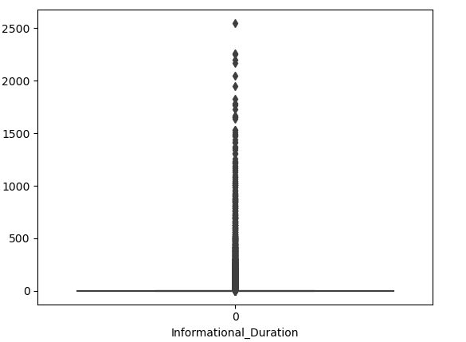
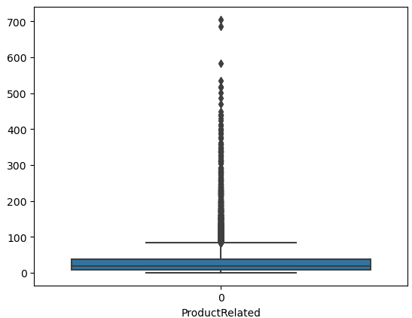
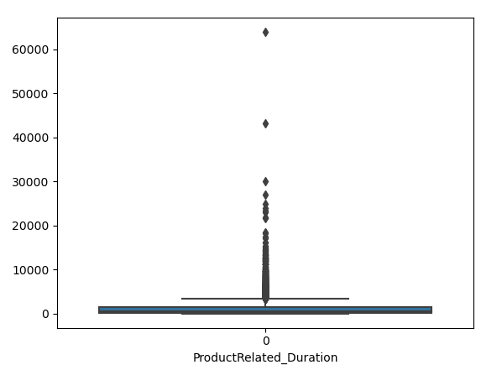

Slide 13
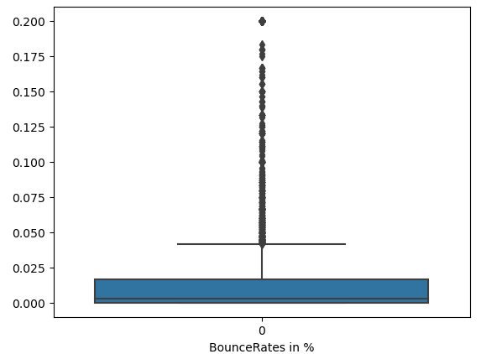
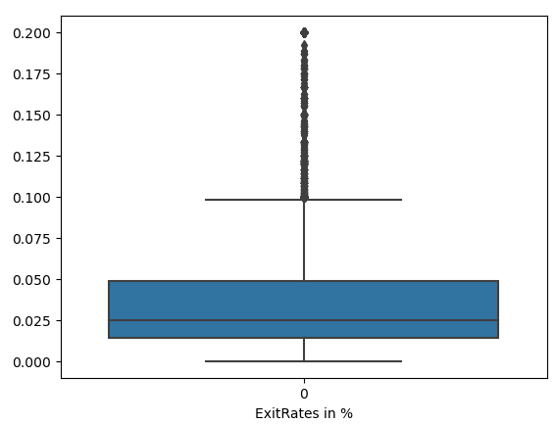
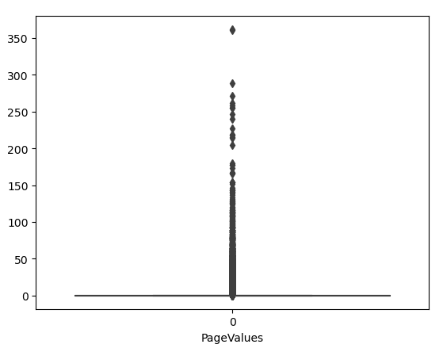
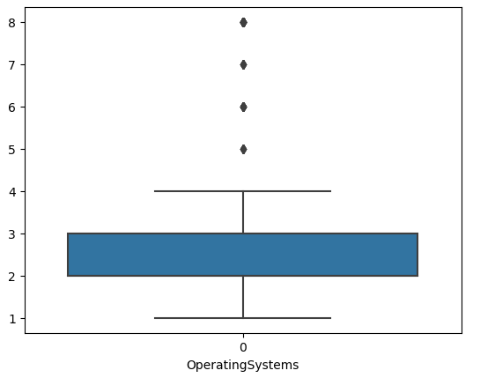
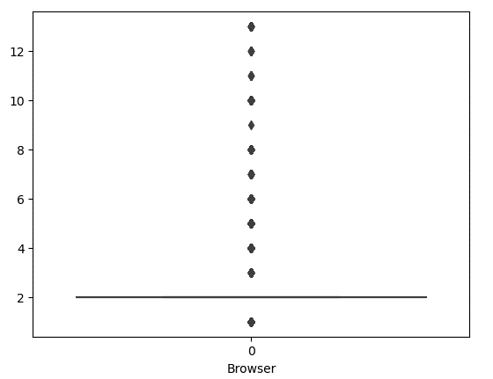
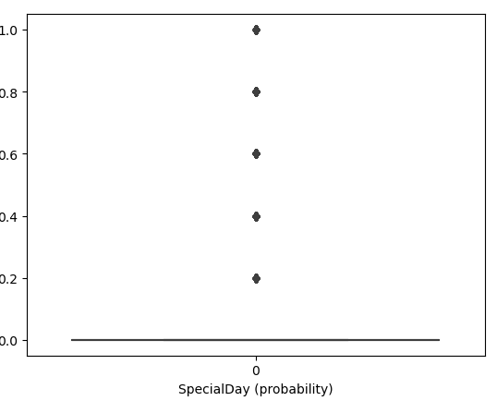

Slide 14
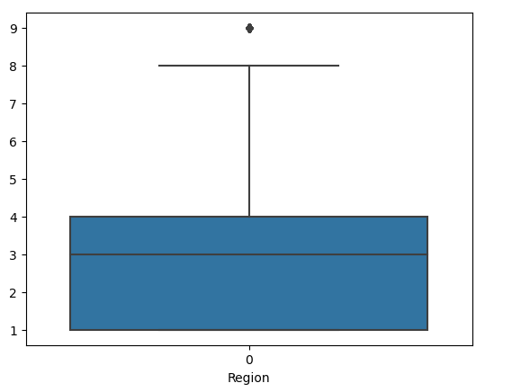
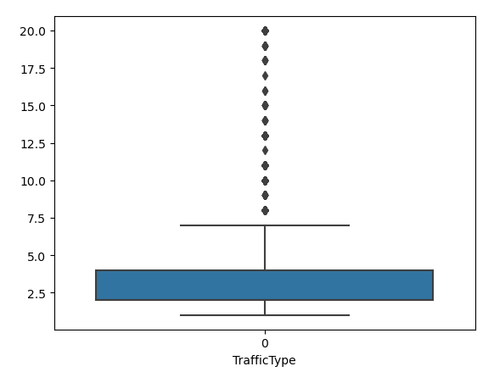

Slide 15
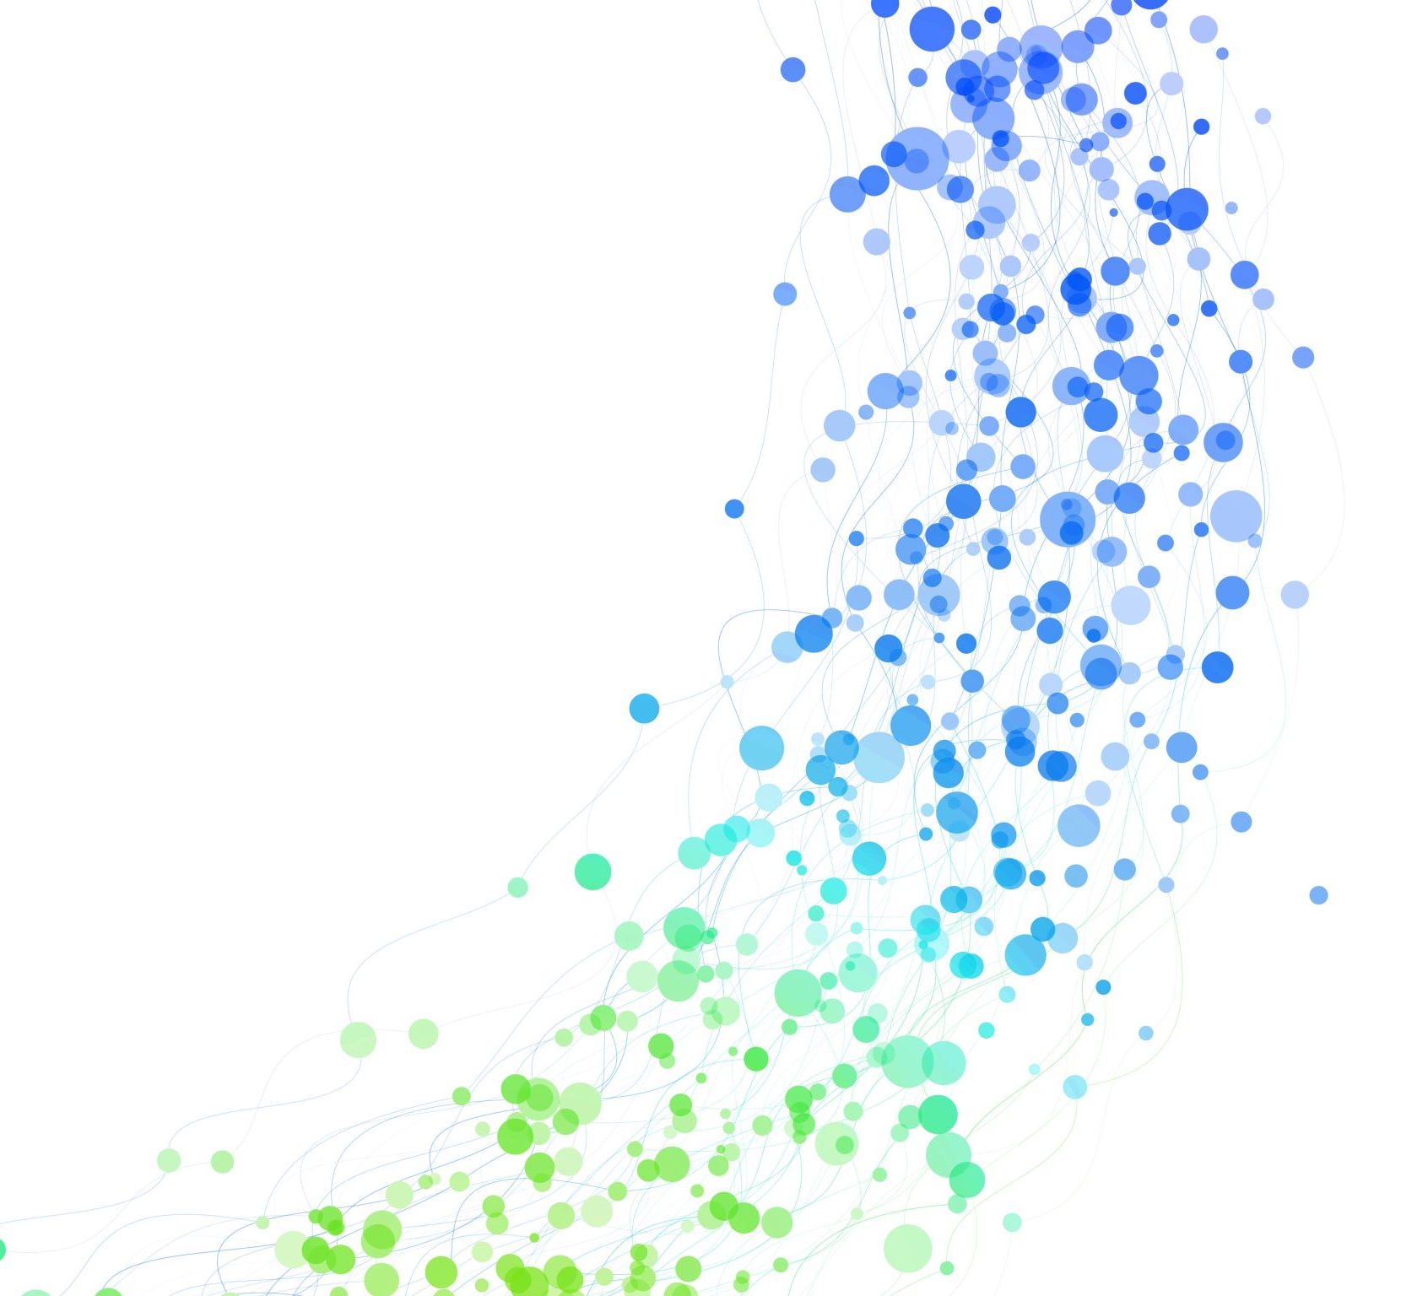
OUTLIERS’ TREATMENT

Slide 16
Checking for Outliers
There are huge outliers in the data as can be seen in the box plots.
Now to treat those outliers, IQR technique is used.
Creating an function outlier_hunt()
Which checks if the data is in iqr range. And check outliers and takes observations.

Slide 17
Operation on outliers.
New dataset-df2 created to show all the outliers using outlier detection function.
Replacing the outliers with median values
In dataset df3. and updating with median values.

Slide 18
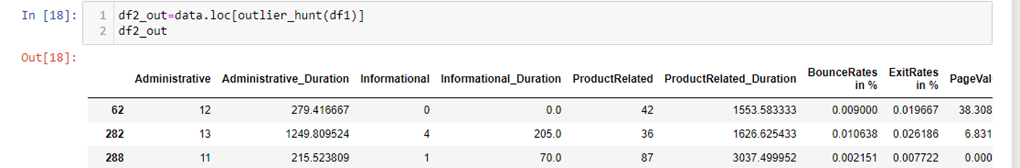


Slide 19
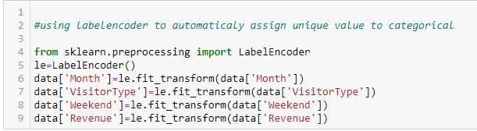
Categorical to numerical
Label encoder function is used to generate unique values for categorical variables.

Slide 20
IMBALANCED DATA

Slide 21
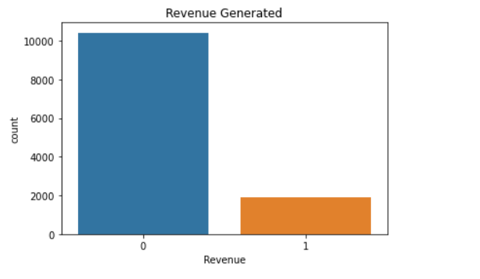
Target column (Revenue)
There is uneven and skewed distribution of data in the target column.
The data is imbalanced.

Slide 22
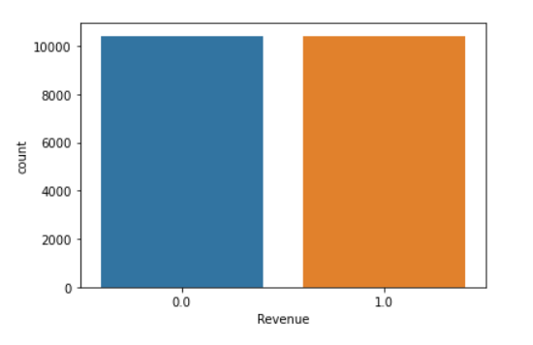
SMOTE Method
To balance the data, SMOTE method is used by oversamping the minority class, i.e., class 1.
The target column looks like this after balancing.

Slide 23
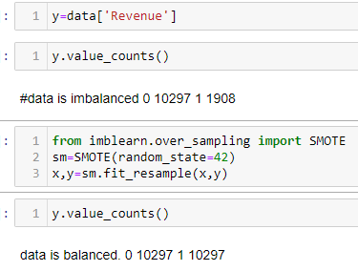
Initially, the Values for Class 0 and Class 1 were 10297and 1908 respectively.
After balancing the data the values for Class 0 and Class 1 were 10297 and 10297 respectively.

Slide 24

TEST TRAIN SPLIT

Slide 25
Train Test Split
Splitting the data into train set and set set.
70% of the data is used for training the models.
Rest 30% is used for testing the models.

Slide 26
MODELLING

Slide 27
Model Selection
According to the problem statement, the problem is that of classification of shoppers whether they fall in revenue generating category or not.
For the current scenario three models have been selected, on which the modelling will be done.
The models that will be used in this project are:
Logistic Regression
Random Forests
Naïve bayes
Decision tree
KNNclassifier
XGBoost

Slide 28

CLASSIFICATION REPORT

Slide 29
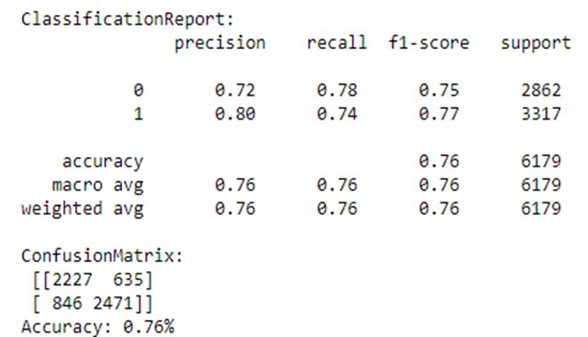
Logistic Regression
The accuracy for logistic regression came as 76%

Slide 30
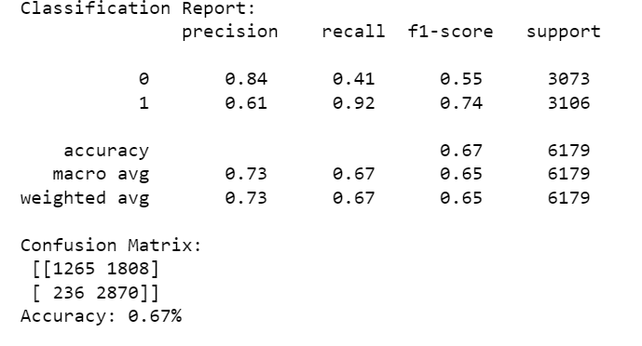
Naïve bayes
The accuracy for logistic regression came as 67%

Slide 31
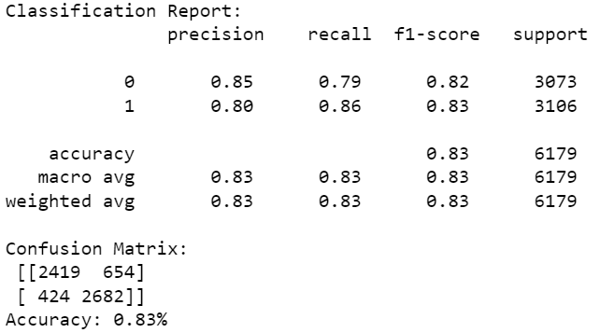
Decision tree
The accuracy for logistic regression came as 82%

Slide 32
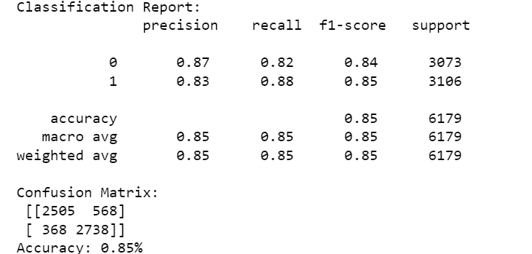
Random forest
The accuracy for logistic regression came as 85%

Slide 33
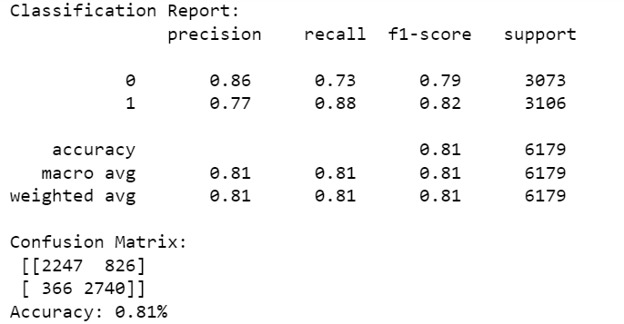
KNNclassifier
The accuracy for logistic regression came as 80%

Slide 34
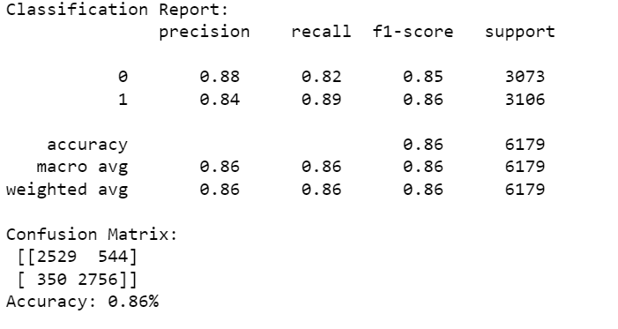
XGBoost
The accuracy for logistic regression came as 86%

Slide 35
OBSERVATIONS & CONCLUSION

Slide 36
DATASET
Dataset could have been much more clear.
Features(columns) like
Browser
Region
Operating system
Could have made categorical for better understanding customer. And for business purposes.

Slide 37
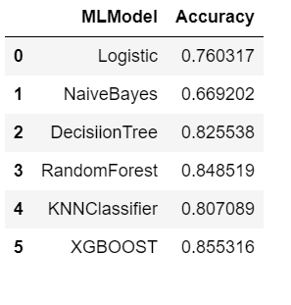
models
Xgboost performed better in dataset.
Randomforest also did better.

Slide 38

THE END

